Slide 1
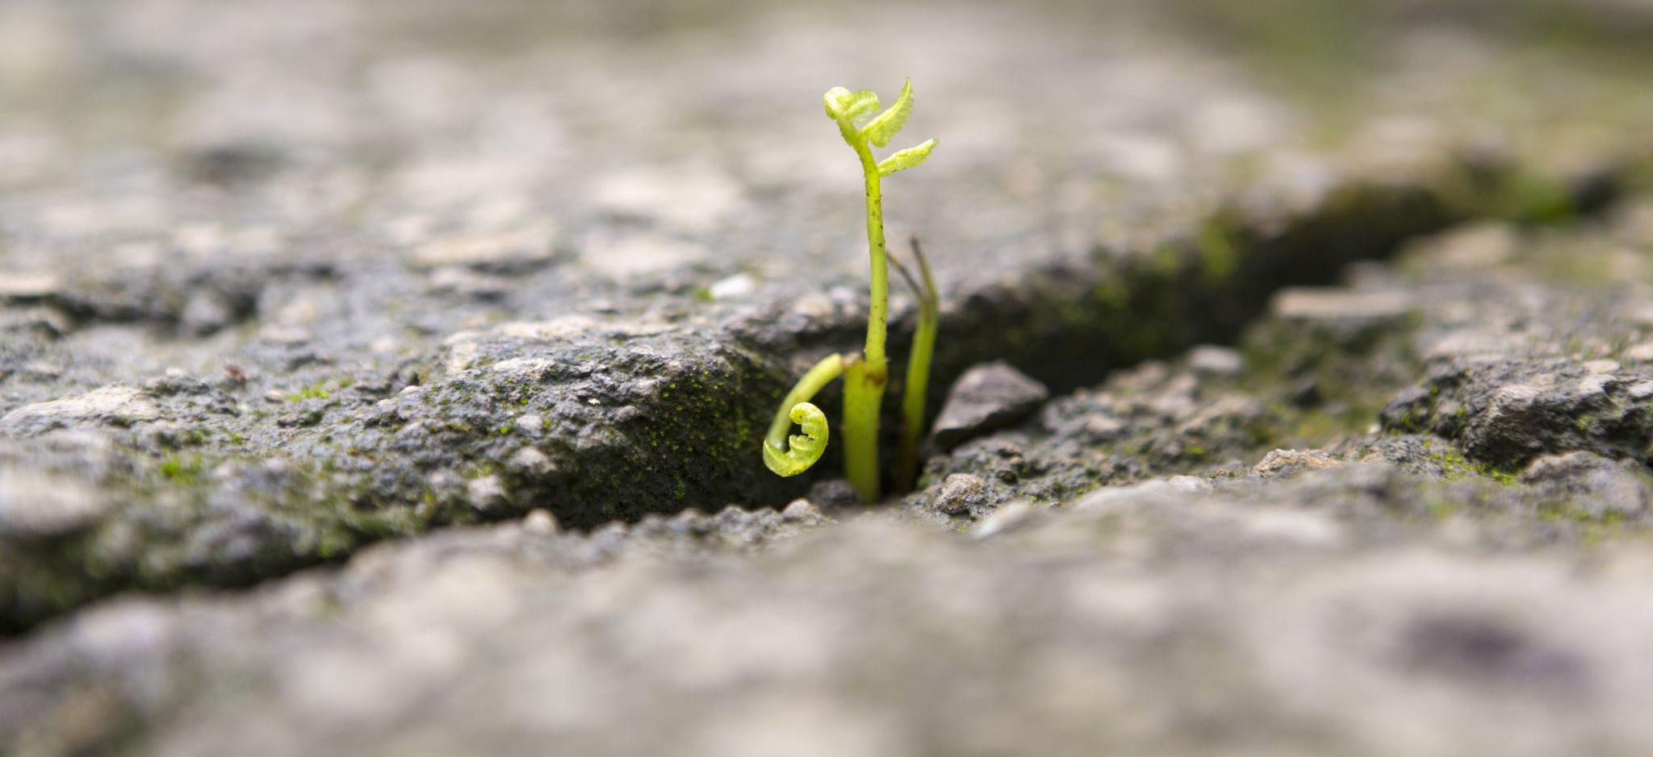
Self-leadership for Resilience
Dr. Inmaculada Adarves-Yorno (Inma)

Slide 2
Check in

Slide 3
Today’s masterclass
What is resilience
Resilience Mindset
Resilience Lifestyle
Resilience tools and techniques
Togetherness and resilience

Slide 4
RESILIENCE
The capacity to deal with stress and adversities
The ability to grow from those stressors and adversities
The readiness to welcome challenges

Slide 5
Case study: A brilliant manager slowly lost her capacity to deal with challenges
Consequences for her
Wrong decisions
Wrong assumptions
Made negative inferences
Miscommunication
Consequences for employees
Demotivation
Distrust
Lack of communication
Lower productivity

Slide 6
Why is resilience important for leaders?
Having low resilience is expensive!
Low effectiveness
Poor communication
Bad decision making
Poor performance
Contagion effect for employees

Slide 7

Resilience MINDSET

Slide 8
MEANING
The most important factor that affect resilience is the MEANING you give to the adversity (Neenan, 2009)

Slide 9


Our beliefs and attitudes will shape the meaning of adversity
”Look what life is doing TO me”
“Life is doing this FOR me”
Wonderful challenges
Failure is success upside down

Slide 10
“The 10th of April was the worst day of my life”
Yet
Thanks to that day, my life is better than has been

Slide 11
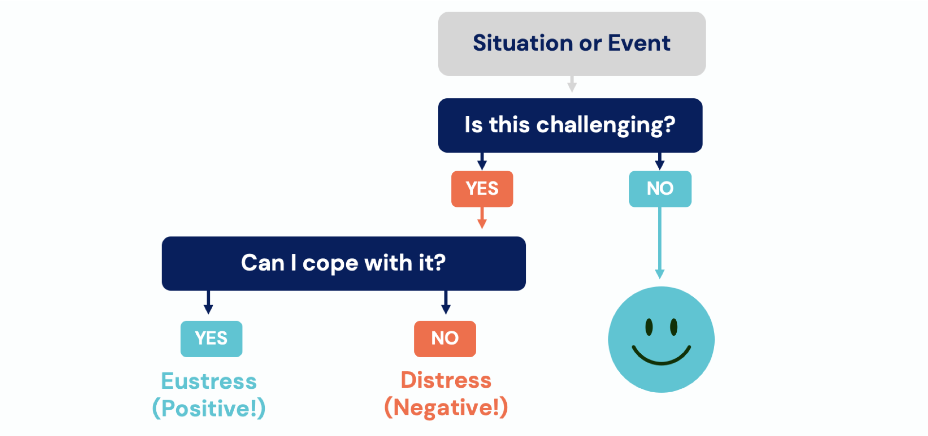
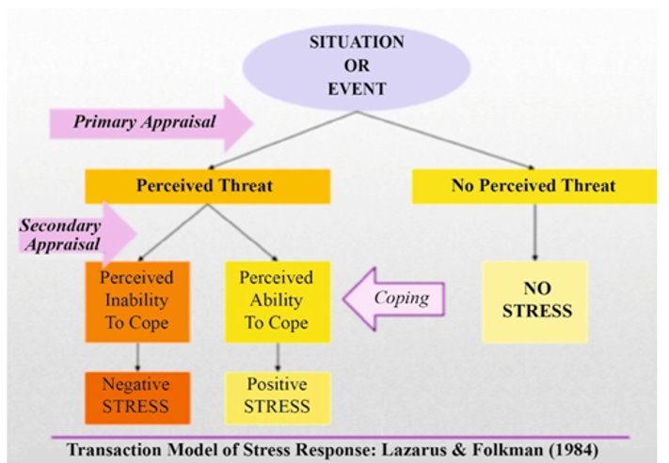
Appraisal and perception

Slide 12

Resilience LIFESTYLE

Slide 13
Relationship with yourself
Relationship with your body
Relationship with your mind
Relationship with your emotions

Slide 14
Relationship with yourself
Being your worst critic vs being a kind companion.
Self-compassion https://self-compassion.org/test-how-self-compassionate-you-are/
Are you taking care of the person underneath your skin?

Slide 15
Relationship with your body
Sleep
Food
Exercise
Respecting our cycles

Slide 16
Relationship with your mind
Are you letting your thoughts drive your day or are you regulating your thoughts?
Are you aware of what is happening in your mind and the effect that it has on your body?
What are you feeding your mind with?

Slide 17
Mind states create physiological stress or restoration (Epel, 2022)
Acute stress (fight and flight)
High cognitive load (High arousal)
Rest (relaxing leisure)
Deep restoration (deep sleep or mind-body practices)

Slide 18
Physiological stress per day

Slide 19
Relationship with your emotions
A meta-analysis study has shown that avoidant and repressive coping strategies are linked with cancer and cardiovascular disease (Mund and Mitte, 2012).
How do you deal with your emotions?

Slide 20
A pause to reflect

Slide 21

RESILIENCE Techniques and Tools

Slide 22
Affective neuroscience model for boosting resilience (Tabibnia, 2020)
Up-regulating the positive→ positivity boosting strategies
Mesostriatal Reward Networks.
Down-regulating the negative → distress reducing strategies
Amygdala
Transcending the self → self-transcending strategies
Default mode network.

Slide 23
Our mind
Up with the positive
Gratefulness practice
Down with the negative
Cognitive re-appraisal
“Look what Life is doing FOR me”
Transcending self
Perception of Common Humanity

Slide 24
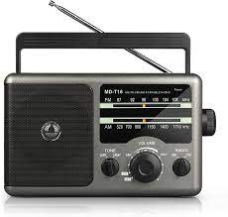

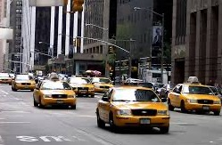
3 quick 'Mindfulness Plus' techniques
Radio technique
Taxi technique
Waterfall technique
Notes:
Mindfulness:
To be present right here, right now
Fully aware
Engage with that reality with non-judgement and non-reactivity
Our research shows that mindfulness predicts resilience (Adarves-Yorno et al., 2020)
Self compassion
Is being your worst critic helpful?
Self-compassion.org
Learning how to become a friend
Altriuism

Slide 25
Our emotions
Up with the positive
Evoking positive memories or sensations
Down with the negative
“Noticing and letting go”
Transcending self
Connecting with a sense of Awe

Slide 26
Our bodies
Up with the positive
Laughter yoga
Down with the negative
Releasing energy through exercise
Transcending self
Feeling the 5 senses in nature

Slide 27
Self-leadership “in action”
What can you actively do in your day-to-day to build resilience?
What are you motivated to do in your day-to-day to build resilience?
What obstacles may you face when you try to engage in pro-resilience practices?

Slide 28

Resilience and Togetherness

Slide 29
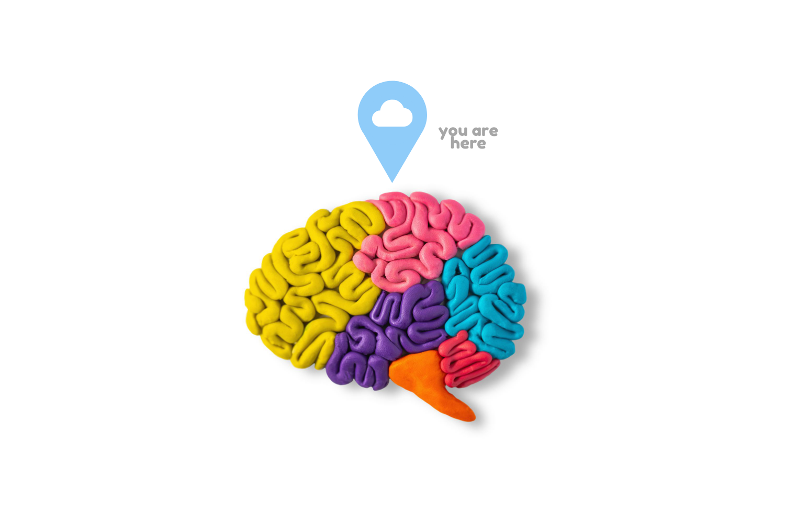
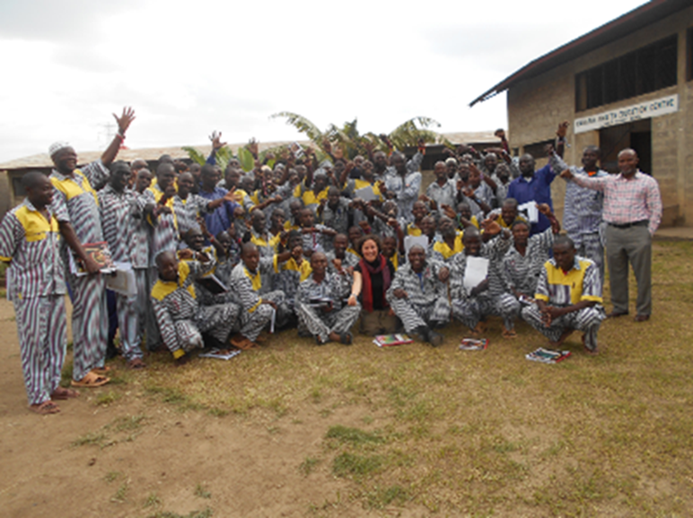
Resilience
Identification with mindful leaders
Adarves-Yorno, et al. (2020)

Slide 30
Belongingness, groups and resilience
What are the groups you belong to, and how do they impact you, your wellbeing and resilience?
Can you belong to new groups that will have a positive impact?
Can you detach yourself from groups that have a negative impact?

Slide 31
Summing up
Resilience Mindset
Resilience Lifestyle
Resilience tools and techniques
Togetherness and resilience

Slide 32
Resources to build your resilience
https://www.robertsoncooper.com/downloads-resources/
Reich, J. W., Zautra, A., Hall, J. S., (2010) Handbook of adult resilience New York: The Guildford Press (Library)
Boyatzis, R. & McKee, A. (2005) Resonant leadership. Boston: Harvard Business School Press (chapter on Mindfulness on ELE)
M, Neenan (2009). Developing resilience: A cognitive behavioural approach . London: Routledge
http://www.psychologytoday.com/basics/resilience

Slide 33
What’s next?
Do you want more information and further training on becoming more resilient? Contact the DA team (e.g., Fernando Correia, F.Correia@exeter.ac.uk)
Do you want to explore a potential resilience training for your organisation? We can look into a Knowledge Exchange Partnership.
Do you want to be informed and potentially take part in resilience projects, research and training? Visit and join us https://sites.exeter.ac.uk/resilience-alive/intro/
Do you need help 1-2-1 to develop your resilience further? contact me i.adarves-yorno@ex.ac.uk

Slide 34
Check out

